Slide 1
ASTROSAGE ANALYICS
FATHIMA ARSHI

Slide 2

AstroSage is a leading AI-powered astrology platform offering personalized horoscope readings, AI-based Kundli generation, and consultations with both AI and human astrologers through AstroSage Varta. With its advanced technology, user-friendly multilingual app, and free astrology services, AstroSage serves millions of users worldwide, boasting over 6.75 crore downloads and 1.2 million daily active users.
Overview
A dedicated astrology-based call centre providing expert guidance
Connects customers with professional astrologers for personalized predictions
Services Offered
Horoscope analysis and future predictions
Kundli matching and relationship guidance
Career, finance, and health-related consultations
Why It Stands Out
24/7 accessibility for astrology queries
Experienced astrologers with diverse expertise

Slide 3

How Astrosage Call Centre Works
Customer Interaction Process
Customer calls for an astrology consultation
Assigned to an expert astrologer
Personalized analysis & predictions given
Feedback and follow-up services available
Technology & Support
AI-powered astrology insights
Secure and efficient customer management system
Multiple language support for diverse audiences

Slide 4

DATA OVERVIEW
The dataset was sourced from AstroSage’s internal consultation system, covering both call and chat consultations conducted between December 2023 and January 2024.
It includes detailed records of astrologer–user interactions, providing insights into engagement, satisfaction, and revenue patterns.
Key fields such as agent name, user ID, call time, rating, consultation type, and revenue form the foundation for analyzing performance and trends.
Data cleaning was performed to remove duplicates, missing values, and irrelevant entries, ensuring accuracy and consistency.
The refined dataset enables meaningful analysis of agent performance, consultation trends, and platform usage to identify improvement opportunities and optimize revenue.

Slide 5
PROJECT OVERVIEW AND OBJECTIVE
METHODOLOGY
AstroSage offers astrological consultations via calls and chats across platforms.
The project analyzes call center operations using real-time consultation data.
Objective: Build an Excel dashboard to visualize trends, agent metrics, and call patterns.
Goal: Help AstroSage make strategic decisions to boost efficiency and user satisfaction.
Cleaned the dataset by removing irrelevant columns and finalizing required fields.
Created pivot tables for analyzing agent performance, call patterns, and revenue trends.
Designed a multi-page dashboard in Excel using slicers and navigation buttons.
Implemented interactivity by linking charts with filters (month, website, consultation type).
Visualized key metrics using bar, line, donut, and stacked column charts.

Slide 6
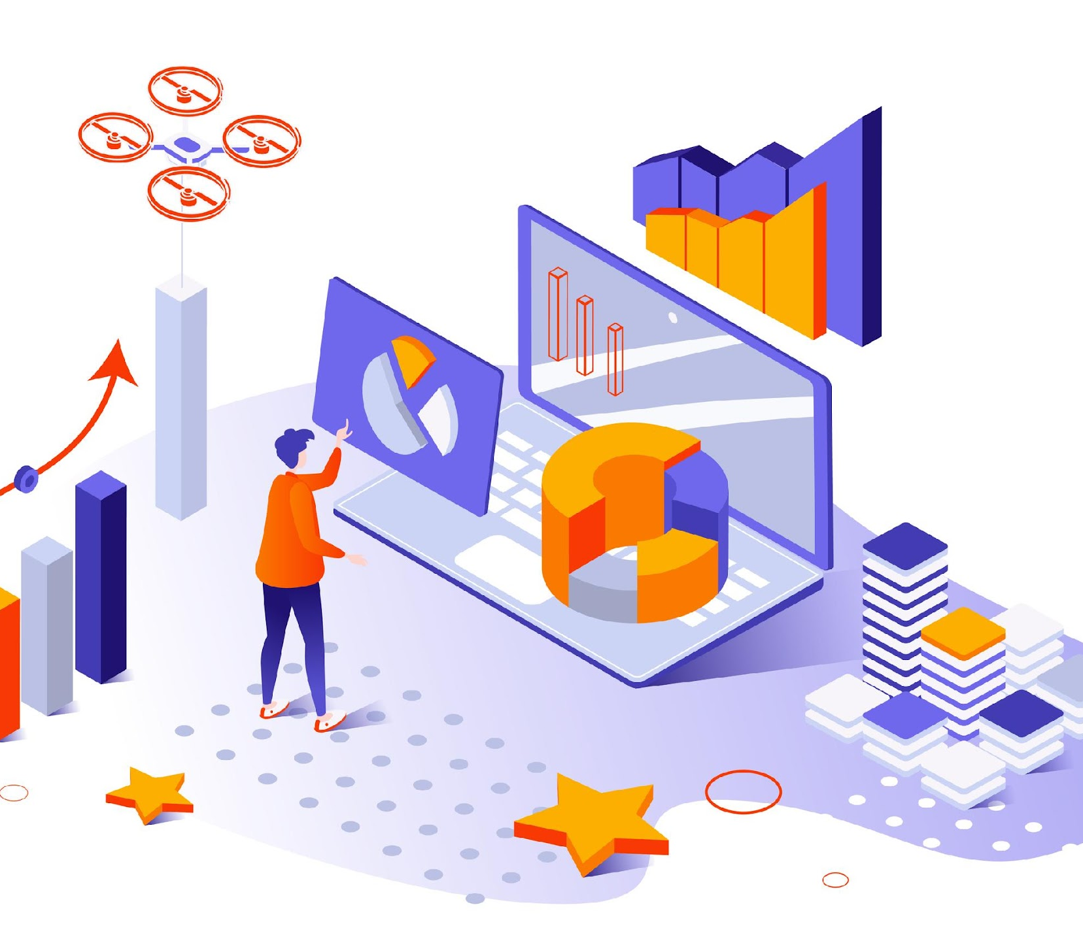
ANALYSIS

Slide 7
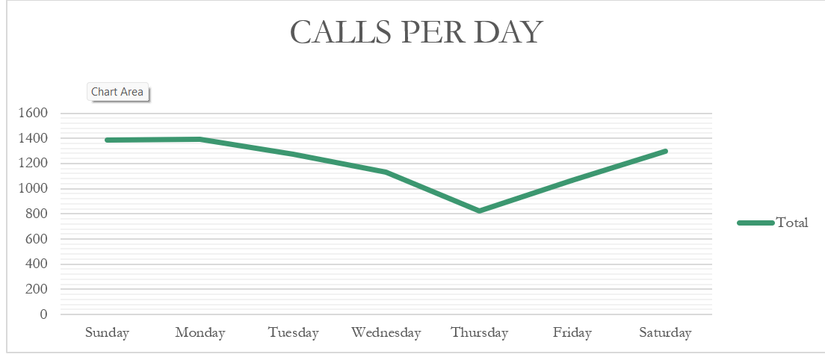
CALLS PER DAY
Highest calls: Sunday & Monday (~1400).
Lowest calls: Thursday (~800).
Midweek: Decline from Tuesday to Thursday.
End of week: Recovery on Friday & Saturday (~1300).

Slide 8
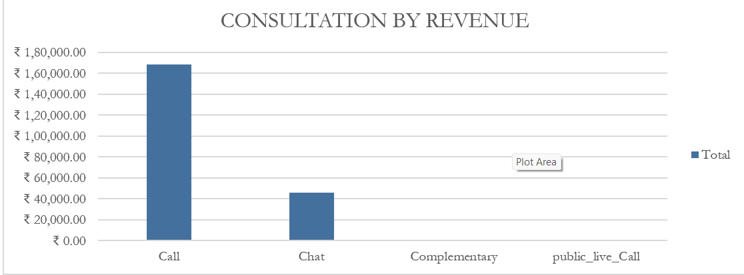
CONSULTATION BY REVENUE
Calls generate the highest revenue (~78%), so call consultations are the core business driver.
Chats contribute moderate revenue (~22%), but far less than calls.
Complementary & Public Live Calls bring negligible revenue, likely serving as free/promotional tools.

Slide 9
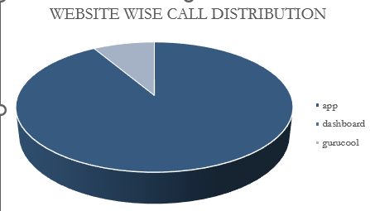
WEBSITE WISE CALL DISTRIBUTION
App generates the highest number of calls, showing it’s the main platform for customer engagement.
Dashboard contributes very few calls.
Gurucool has almost negligible share

Slide 10
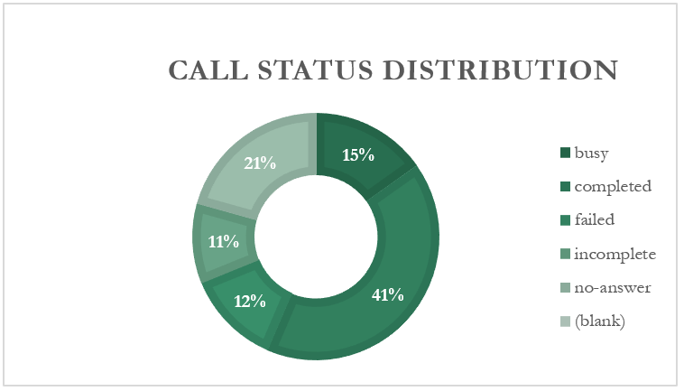
CALL STATUS DISTRIBUTION

Slide 11
Completed Calls – 41%: This is positive as the largest share of calls are successfully completed.
No Answer – 21%: A significant issue – nearly 1 in 5 calls go unanswered. This shows missed opportunities and needs urgent attention.
Busy – 15%: Customers are frequently engaged, suggesting possible capacity or staffing issues.
Incomplete – 12% & Failed – 11%: Together, they make up 23% of calls, indicating technical or process gaps.
CALL STATUS DISTRIBUTION

Slide 12
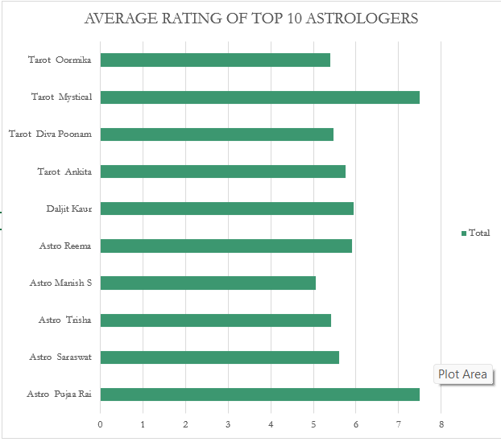
AVERAGE RATING OF TOP 10 ASTROLOGERS

Slide 13
AVERAGE RATING OF TOP 10 ASTROLOGERS
Top Performers: Tarot Mystical (~7.5) and Astro Pooja Rai (~7.5) have the highest ratings, showing strong client satisfaction and trust.
Consistently Good Performers: Tarot Ankita, Daljit Kaur, Astro Reema, Astro Saraswat, Tarot Diva Poonam, and Astro Trisha all score around 6, showing reliable and positive feedback.
Lower Ratings: Tarot Oormika and Astro Manish S are slightly below average (~5.2–5.5). They may need improvement in client engagement or accuracy.

Slide 14
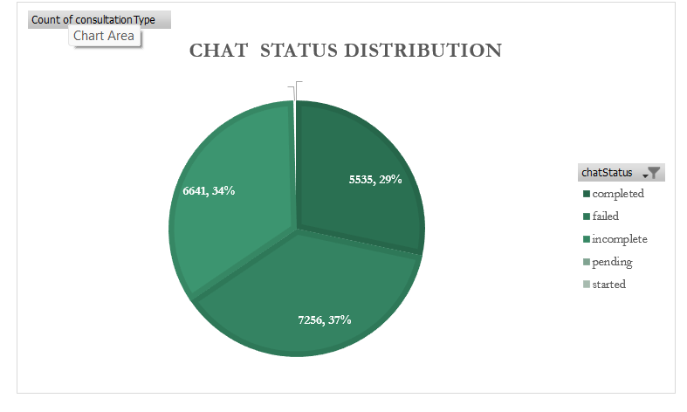
CHAT STATUS DISTRIBUTION
Most chats are pending (37%), meaning many users start but don’t finish the chat.
Incomplete chats (34%) show that many conversations stop before they are done.
Only 29% of chats are completed, so the chat process needs improvement to help more users finish their consultations.

Slide 15
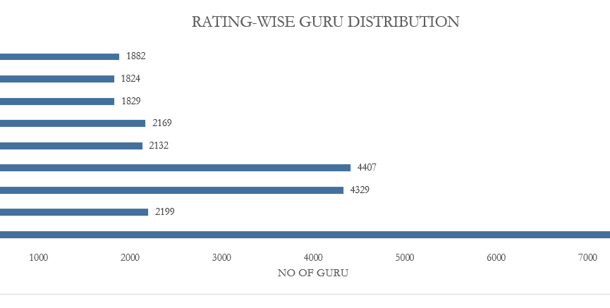
RATING-WISE GURU DISTRIBUTION
Most gurus have a rating of 0 (7,256), showing many are new or haven’t received feedback yet.
Average ratings (3–4) are common, meaning most gurus give satisfactory but not top-quality service.
High ratings (6–8) are fewer, showing only a small group of top performers.

Slide 16
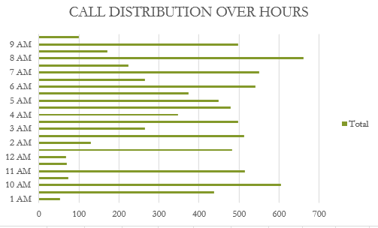
CALL DISTRIBUTION OVER HOURS
Peak call activity occurs between 7 AM – 10 AM, showing highest customer engagement in the morning.
Moderate traffic continues until 4 PM, aligning with working hours.
Low activity is seen during late evening and early morning (8 PM – 3 AM).

Slide 17
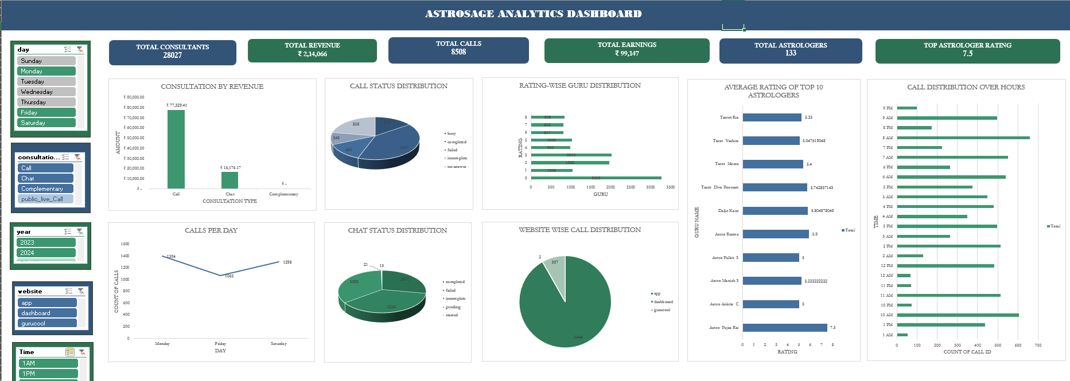
DASHBOARD - ASTROSAGE

Slide 18
STRATEGIC RECOMMENDATIONS
1. Revenue Growth
  Focus on Calls since they bring ~75% of revenue.
  Promote chat consultations with discounts & bundles to diversify income streams.
  Reduce free/complimentary sessions → optimize for revenue.
2. Improve Call Completion
Address 21% no-answer & 12% failed calls by:
  Automated reminder notifications before scheduled calls.
  Better queue management system.
  Hiring support staff to reduce busy/incomplete rates.

Slide 19
3. Astrologer Performance Management
  Create Top Performer Rewards Program (bonus for >7 rating).
  Offer training & mentoring to astrologers with <6 rating.
  Rotate high-demand astrologers to balance workload.
4. Customer Engagement
  Boost activity on low-performing days (Thursday) with campaigns & promotions.
  Increase customer retention programs (loyalty rewards, personalized follow-ups).
5. Channel Optimization
Double down on App channel, as it contributes the most.
Review ROI of Gunucool (low calls) – either scale marketing or phase it out.

Slide 20
6. Long-Term Growth
Introduce subscription packages (weekly/monthly consultations).
Cross-sell astrology products (reports, remedies, gemstone recommendations).
Use AI-based matching – pair clients with astrologers who fit their query type.
CONCLUSION
Astrosage shows strong growth with a solid consultant base and call consultations driving most revenue. However, high call drop rates and underperforming days (like Thursday) indicate efficiency gaps. The app is the main revenue channel, but other platforms remain underutilized. While top astrologers maintain good ratings, overall performance can improve with training and incentives. Optimizing call management, boosting weaker channels, and balancing daily demand will enhance revenue and customer satisfaction.

Slide 21
THANK YOU

